Slide 1
EU funding Oppotunities
Notes:
The "Europe Day" of the EU was introduced in 1985 by the European Communities (the predecessor organisation of the EU) The date of commemorates the Schuman Declaration of 9 May 1950. The declaration proposed the pooling of French and West German coal and steel industries, leading to the creation of the European Coal and Steel Community, the first European Community, established in 1952

Slide 2
Greater Copenhagen EU Office

Slide 3
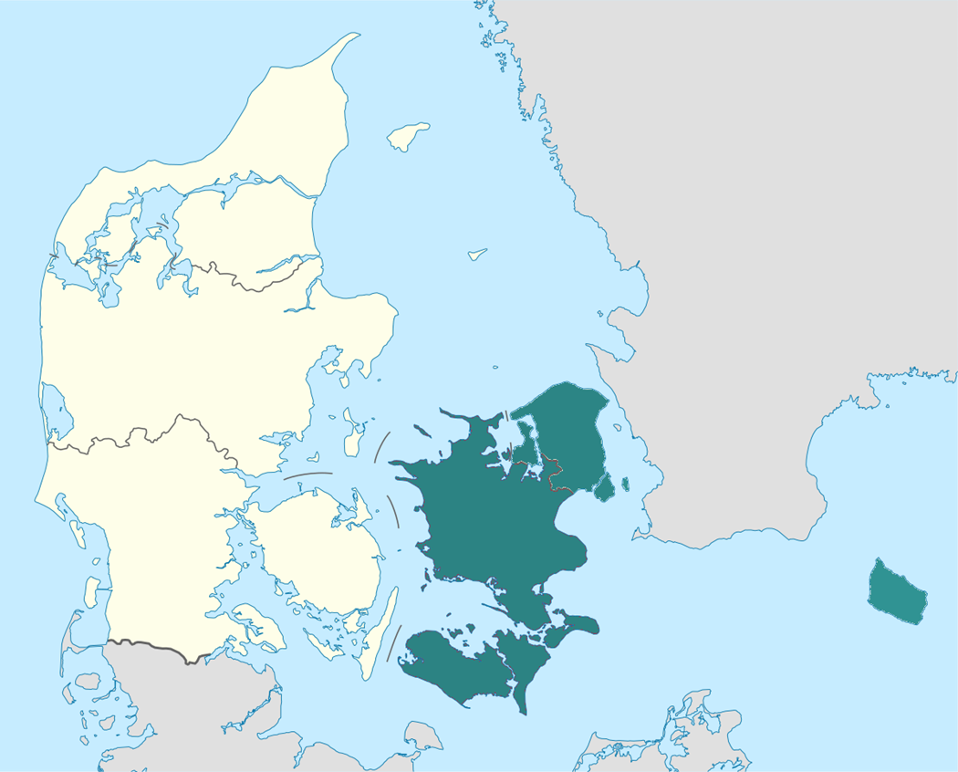






GREATER COPENHAGEN EU OFFICE
TO REGIONER
FIRE UNIVERSITETER
46 KOMMUNER
ALBERTSLUND
ALLERØD
BALLERUP
BORNHOLM
BRØNDBY
DRAGØR
EGEDAL
FAXE
FREDENSBORG
FREDERIKSBERG
FREDERIKSSUND
FURESØ
GENTOFTE
GLADSAXE
GLOSTRUP
GREVE
GRIBSKOV
GULDBORGSUND
HALSNÆS
HELSINGØR
HERLEV
HILLERØD
HOLBÆK
HVIDOVRE
HØJE-TAASTRUP
HØRSHOLM
ISHØJ
KALUNDBORG
KØBENHAVN
KØGE
LEJRE
LOLLAND
LYNGBY-TAARBÆK
NÆSTVED
ODSHERRED
RINGSTED
ROSKILDE
RUDERSDAL
RØDOVRE
SLAGELSE
SOLRØD
SORØ
STEVNS
TÅRNBY
VALLENSBÆK
VORDINGBORG

Slide 4
STRATEGY 2019 - 2022
Mission: Greater Copenhagen EU Office engagerer medlemmerne i europæisk samarbejde, der styrker forskning, innovation og udvikling i Østdanmark.
Goals:
  Contribute to EU financing of at least DKK80 million for regions, municipalities and companies
  Facilitate at least 10 EU-applications with participation from different members
  Support the interests of the members and account for the effect using cases
Points of orientation: The Greater Copenhagen partnership and the SDGs
What happens in the EU: Brexit, new EP, new Commission, new budget, new programs
4

Slide 5
FOCUS AREAS
Health
Climate, environment, circular economy, energy
Mobility and infrastructure
Digital technologies
Bio-economy and food
CopenVirk
5

Slide 6
LOBBYING
Knowledge about the political context (external factors and political priorities).
Knowledge about the research paradigm (enhance the competitiveness of the EU through research and innovation and solve societal challenges.
Knowledge about the EU-programs – creation and cycle especially Horizon (decision making processes).
Intelligence – understand opportunities and the EU-institutions.
Knowledge of the strong research areas of our members.
6

Slide 7
PROJECT DEVELOPMENT
ACTIVITIES
Gather knowledge about project interests and potential strong partnerships
Analyze and advise
Motivate and building competences
Match-making
Workshops and conferences
Meeting in DK
Show competences in Brussels in order to create partnerships
PREREQUSITES
Timing (is everything)
State of the art and beyond
Relevant local challenges
International network (across disciplines)
Match with possibilities
Project ideas with European added value
Support from the management (resources)
Anchorage in the organization
Project resources
7

Slide 8
WHAT IS IN IT FOR THE MUNICIPALITIES?
Extra resources to implement existing local priorities
Access to new high quality knowledge
Futureproof solution based on new and larger test facilities
The municipality can share expertise and get new knowledge in return
International partners can challenge the Danish project managers and make them think outside the box
Development of the organization and employees – creating better solutions for the citizens
Implement ambitious policies
The municipality is an attractive place to work
CHEF MED FOKUS PÅ UDVIKLING
CHEF MED FOKUS PÅ UDVIKLING
8

Slide 9
PRE-PROJECT SUPPORT
Greater Copenhagen EU Office gives counseling and financial support to our members when they are applying for EU-support.
Financial support for regions, municipalities and universities:
Project coordinator: DKK100.000
Project partner: DKK30.000
Financial support is paid after the EU-application has been submitted.
Maximum DKK200.000 per year per region/municipality/university.
Universities can only receive financial support if they partner with a member-municipality.
9

Slide 10
EU-programs

Slide 11

HORIZON 2020
HORIZON 2020
Purpose: Horizon 2020 is the biggest EU Research and Innovation program with its emphasis on excellent science, industrial leadership and tackling societal challenges.
Partnership: Three partners from three different countries
Budget: 77 billion € for the period 2014-2020
EU-support: Up to 100%
Next deadlines: Mainly in September 2019 and Januar and Maj 2020
Notes:
Health, demographic change and wellbeing
Food security, sustainable agriculture and forestry, marine and maritime and inland water research and the bioeconomy
Secure, clean and efficient energy
Smart, green and integrated transport
Climate action, environment, resource efficiency and raw materials
Europe in a changing world - inclusive, innovative and reflective societies
Secure societies - protecting freedom and security of Europe and its citizens.

Slide 12

LIFE
LIFE
Purpose: Support development and execution of the environmental goals and legislation of the EU.
Partnership: There is no demand for international partnership, but it will add points in the evaluation. Public authorities, universities and companies can be part of the projects.
Themes: Nature and biodiversity, environment, climate and information and governance.
EU-support: Between 55%-60%
Budget: 3,5 billion. €
Deadlines: Deadline for concept notes (2-tier applications) in June 2019 and deadline for the full application January 2020. The 1-tier application has a deadline in September 2019.
Notes:
Help move towards a resource-efficient, low carbon and climate resilient economy, improve the quality of the environment and halt and reverse biodiversity loss;
Improve the development, implementation and enforcement of EU environmental and climate policy and legislation, and act as a catalyst for, and promote, the mainstreaming of environmental and climate objectives into other policies and practices;
Support better environmental and climate governance at all levels, including better involvement of civil society, NGOs and local actors;
Support the implementation of the 7th environmental action plan.

Slide 13

URBAN INNOVATIVE ACTION
Urban Innovative Action
Purpose: Provide urban areas throughout Europe with resources to test new and unproven solutions to address urban challenges.
Partnership: No demand for transnational partnerships. The applicants need to be one or more local authorities with a collected urban population of at least 50.000 people.
Themes: Air Quality, Circular Economy,
Culture and cultural heritage, and Demographic change
EU-support: 80%.
Budget: 372 million €, Pr. project: up to 5 million €
Deadlines: Launch of call is September 2019

Slide 14
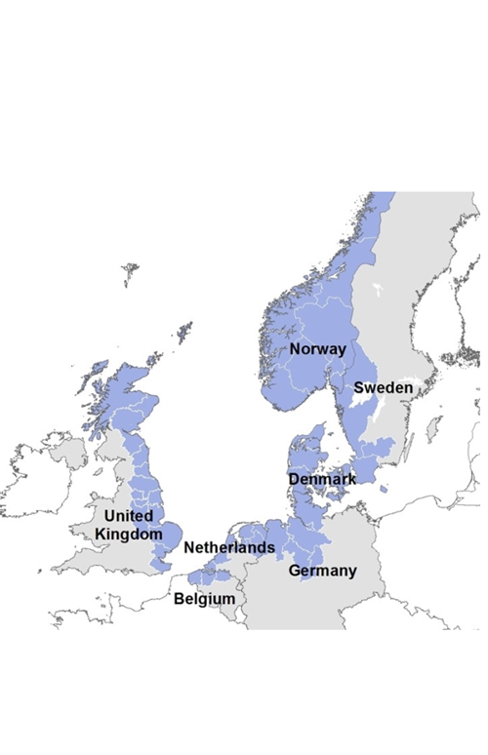
INTERREG NORDSØ
Interreg North Sea Region
Purpose: Support development and foster sustained economic growth across the region.
Partnership: Minimum 2 countries - companies (especially SME’s), universities, public authorities and NGO’s
Countries: 49 regions in Norway, Sweden, Denmark, Germany, The Netherlands, Belgium and Great Britain.
Themes: Thinking growth, Eco-innovation, Sustainable North Sea Region, and Green transport and mobility
EU-support: 50%
Deadlines:
Call 12: expressions of interest 28 June 2019 - 11 October 2019.
Notes:
Thinking growth: Strengthening research, technological development and innovation.
Eco-innovation: Preserving and protecting the environment and promoting resource efficiency.
Sustainable North Sea Region: Promoting climate change adaptation, risk prevention and management.
Preserving and protecting the environment and promoting resource efficiency.
Green transport and mobility: Promoting sustainable transport and removing bottlenecks in key network infrastructures.

Slide 15
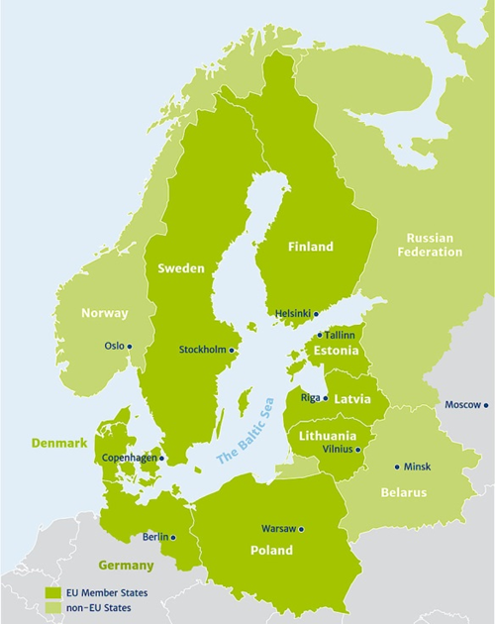
INTERREG ØSTERSØ
Interreg Baltic Sea Region
Purpose: Support integrated territorial development and cooperation for a more innovative, better accessible and sustainable Baltic Sea region
Partnership: Local, regional and national authorities, universities, educational institutions, NGO’s and companies.
Countries: 11 countries: 8 EU-member states and 3 partner countries.
Themes: Capacity for innovation, Efficient management of natural resources, Sustainable transport, and Coordination of the EU Strategy for the Baltic Sea Region
Partnerships: At least 3 partners from at least 3 different countries
EU-support: Up to 85 %
Deadlines: Ultimo 2019.
Notes:
Capacity for innovation: Priority 1 ‘Capacity for innovation’ is dedicated to actions strengthening the ability of the Baltic Sea Region to create and commercialise innovation. Thus, the Programme encourages experimentation with new approaches and solutions to be practically tested through pilot actions. Furthermore, the priority aims at increasing the capacity of the public sector as an innovation driver and enhancing innovation uptake by SMEs. Thematically, one focus of this priority lies on utilisation of the potentials of existing and planned research and innovation infrastructures. Additionally, the priority supports capacity-building for smart specialisation strategies and their implementation, e.g. through test and pilot activities. Lastly, the priority provides support for non-technological innovation.
Efficient management of natural resources: Priority 2 ‘Efficient management of natural resources’ supports transnational cooperation enhancing capacity of public authorities and practitioners to ensure better environmental status of the Baltic Sea Region waters and to strengthen the resource-efficient growth. It will help in developing integrated approaches to reducing nutrient loads and decreasing discharges of hazardous substances to the Baltic Sea and the regional inland waters. Moreover, the Priority supports development and testing of governance and funding models as well as technological solutions for production and distribution of renewable energy and for improved energy efficiency. Lastly, it aims at strengthening sustainable and resource-efficient blue growth in the Baltic Sea Region.
Sustainable transport: Priority 3 ‘Sustainable transport’ covers capacity building measures ensuring more sustainable transport solutions in the region. In particular, it aims to better connecting the secondary and tertiary nodes of transport corridors in the Baltic Sea region to core network corridors, in particular in terms of linking different transport modes. Furthermore, the priority aims to improve accessibility of distant areas that have accessibility deficits as well as areas affected by demographic changes to urban, administrative and economic centres. Due to the significance of maritime transport for the region the priority also focuses on the improvement of maritime safety and environmental-friendly shipping. Finally, the priority specifically focuses on urban areas of the Baltic Sea region with the aim of increasing environmentally friendly mobility in cities.
Coordination of the EU Strategy for the Baltic Sea Region: Strengthening the implementation of the EU Strategy for the Baltic Sea Region (EUSBSR) and ensuring cooperation with the neighbouring countries of the Baltic Sea macro region is an important aim of the Programme.

Slide 16

INTERREG EUROPE
Interreg Europe
Purpose: Creating an environment and opportunities for sharing solutions, we aim to ensure that government investment, innovation and implementation efforts all lead to integrated and sustainable impact for people and place.
Partnerships: Public authorities from at least 3 countries. Typically 5-10 partners.
Countries: All 28 EU-member states.
Themes: Research and innovation, SME competitiveness, Low-carbon economy, and Environment and resource efficiency
EU-support: 85% for public authorities, 75% for private non-profits and 50% for Norwegian partners.
Budget: 359 million €
Notes:
Research and innovation:

Slide 17
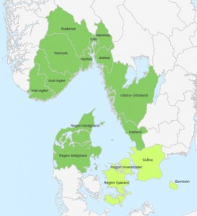
INTERREG ÖRESUND-KATTEGAT-SKAGERRAK
Interreg Öresund-Kattegat-Skagerrak
Purpose: Address the most important cross-border challenges linked to the implementation of the Europe 2020 strategy in this dynamic cross-border region, which includes the metropolitan regions of Copenhagen-Malmö, Gothenburg and Oslo as well as rural areas.
Partnerships: At least 2 partners from 2 different countries.
Geography: Kattegat-Skagerrak: Regions in Denmark, Sweden and Norway
Themes: Innovation, Low-carbon economy, Transport, and Employment
EU-support: Up to 50 %
Budget: 143 million €
.
Deadlines: Next call opens the 9th of August and closes on the 13th September.
Notes:
Innovation
The programme will contribute to a strengthened cross-border research and innovation system capacity, linking it more strongly to the EU and international systems. This includes the European Spallation Source (ESS) and the Swedish research facility MAX IV. Increased commercialisation of innovations and increased business participation in the R&I system are main objectives.
Low-carbon economy
The ÖKS programme will also invest in green growth by increased production and use of renewable energy, by improving and extending distribution networks, by promoting innovation in renewable energy and by decreasing energy consumption in the public sector.
Transport
In the area of connectivity, the programme will support connecting transport corridors with the TEN-T network, mainly by complementing planned TEN-T projects. The connection between central and peripheral parts of the programme area will also be improved.
Employment
Finally, the programme will facilitate employment and cross-border cooperation in micro enterprises, own businesses and new enterprises. It will also increase cross-border mobility through activities aiming at overcoming legal and other border obstacles and supporting qualifications assessment.

Slide 18
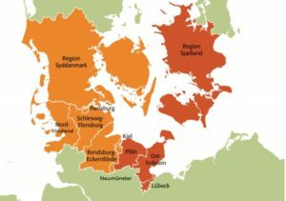
INTERREG DEUTCHLAND - DANMARK
Interreg Deutchland-Danmark
Purpose: Promotes cross-border cooperation between Germany and Denmark.
Partnerships: At least one Danish and one German partner.
Geography: Region Syddanmark og Region Sjælland. Tyskland: Nordfriesland, Holstein, Plön, Rendsburg-Eckernförde og Schleswig-Flensburg og byerne Flensburg, Kiel, Lübeck og Neumünster.
Themes:
  Strengthening research and development efforts to establish sustainable growth of the region,
  Sustainable development in relation to environmental issues and resource efficiency,
  Employment opportunities and the support of mobility in the job market to address the lack of skilled labor
  The improvement of functional cooperation for better institutional capacities and more efficient public administrations.
EU-support: 60 % or 75 %
Budget: ca. 87 million €.
Deadlines: 21st of august 2019,
Notes:
strengthening research and development efforts to establish sustainable growth of the region: Expected results:
Improve cross-border networks amongst different important industries
Increase the use and development of testing and co-creation establishments
Promote innovative product and service developments
sustainable development in relation to environmental issues and resource efficiency:
Expected results (A): Development of green solutions for the improved use of resources and energy
Expected results (B): More and improved cross-border products in the area of sustainable culture and nature tourism
Promotion of employment opportunities and the support of mobility in the job market to address the lack of skilled labor:
Expected results (A): Improved possibilities for the recruitment and holding of qualified specialists
Expected result (B): Developed and tested education measures for strengthening cross-border competences
promotes the improvement of functional cooperation for better institutional capacities and more efficient public administrations. It is separated into two main aims (A and B).
Expected results (A): Institutional cooperation in essential areas and industries of the region and an improved framework for cross-border collaboration
Expected results (B): Enhanced knowledge beyond the border and increased intraregional activities

Slide 19
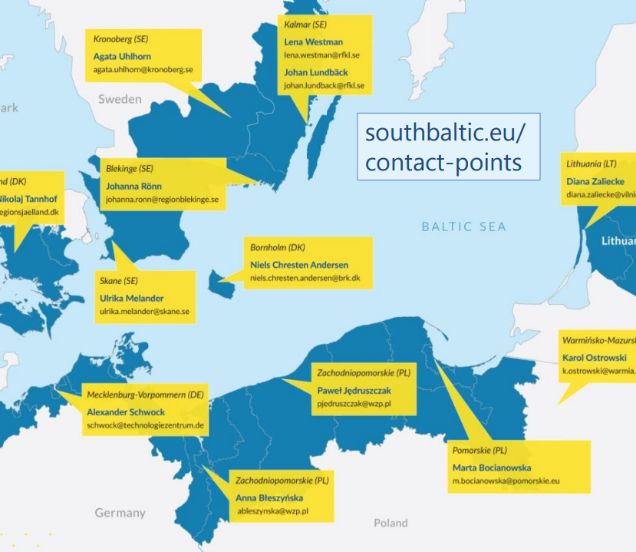
Interreg South Baltic
Interreg South Baltic
Purpose: The Interreg South Baltic Programme aims at unlocking South Baltic’s potential for blue and green growth through cross-border cooperation between local and regional actors.
Partnership: At least 2 partners from 2 different countries
Geography: Denmark, Germany, Lithuania, Poland and Sweden.
  Themes: SME development
  Sustainable tourism
  Green technologies
  Sustainable transport
  Skilled labour force
  Cooperation capacity
EU-support: Up to 50 %
Deadlines: No open calls

Slide 20

URBACT III
URBACT III
Purpose: Help cities to develop pragmatic solutions that are new and sustainable and that integrate economic, social and environmental urban topics
Partnership: 7-10 partners and at least 3 partners from developing regions for Action Planning networks
Themes: Environment, Governance, Inclusion, Economy
EU-support: 70%-80% for Action Planning networks
Budget: Up to 750.000 € pr project for Action Planning networks
Deadlines: No open calls

Slide 21
Other programmes
Erasmus
Creative Europe
Europe for Citizens
EU Health Programme
And so on and so forth…

