Slide 1
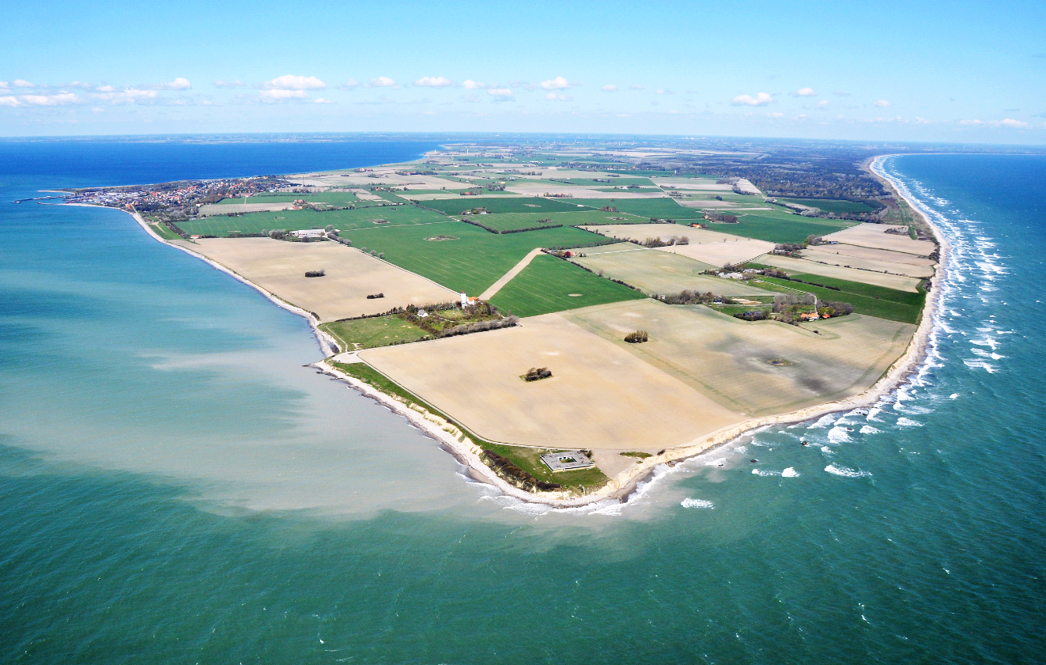

INTERNATIONALT COOPERATION IN
GULDBORGSUND MUNICIPALITY
EU PROJECT OPPORTUNITIES FOR MUNICIPALITIES
EU Day 9 May 2019, Sorø
Frede Danborg, International Coordinator

Slide 2
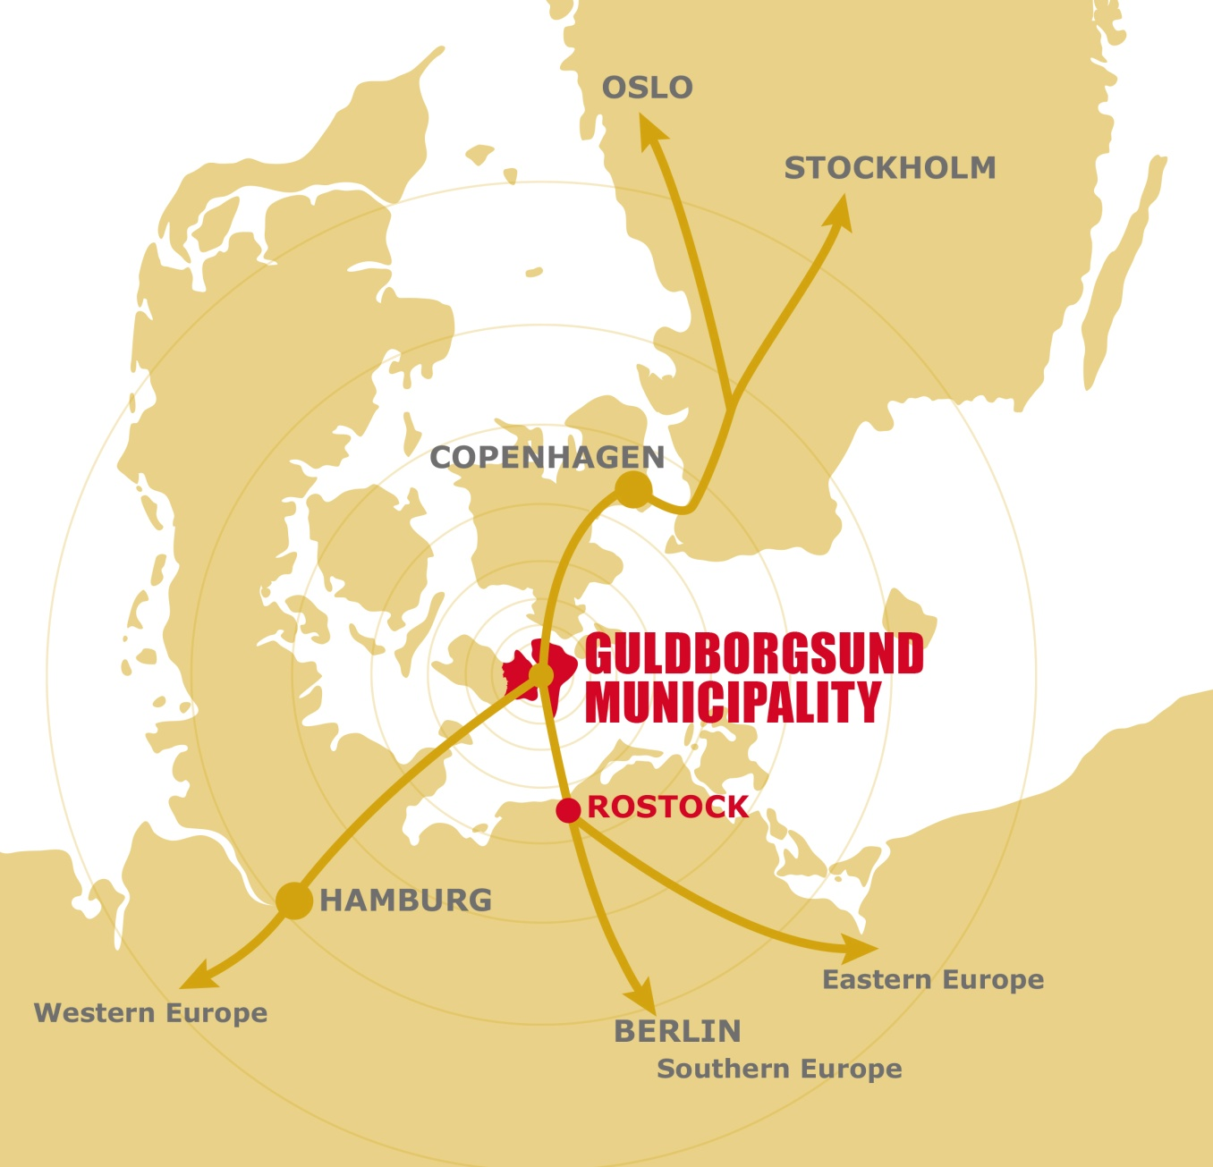

Guldborgsund Municipality
Typical rural municipality
Population 61.000 at 903 km2
80 % of area covered by fields/forests
Main town: Nykøbing with 20.000 inhabitants.
Half the population live in small villages and rural areas
In the South Baltic Sea between Copenhagen, Hamborg and Berlin
Neighbour to Rostock

Slide 3

What do we get from international cooperation?
International cooperation is a specific resource
There is important knowledge and experiences in our neighbouring countries and further out in Europe
They have similar challenges as we have
EU pays the main part of the cooperation
Develop new and better services to the citizens.
Develop solutions and methods for the municipality organisation
Provide network, knowledge and experiences to employees
Branding locally, nationally and among neighbouring countries
Agenda setting, leveraging to further financing and resources

Slide 4
Basic principles for international cooperation
Mainstreaming of the international cooperation:
International cooperation has no own goals, but contributes to political prioritised goals
Seen as a resource to develop the technical centres core tasks
International cooperation is an ordinary tool for development work to reach the municipal goals
All centre and units in the municipality should have the opportunity to benefit from international cooperation.
Organisation
2 international coordinators providing technical support to all centres and departments.
1 international contact persons in each of 9 centres.
Important support from Greater Copenhagen EU Office.

Slide 5



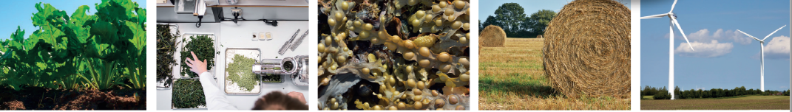
Bioeconomy Hotspot Guldborgsund
Connects science and enterprises
Facilitates new sustaniable local productions LOCAL JOBS
based on local bio resources and residues
in a circular economy
Bioeconomy Hotspot Guldborgsund works with
circular bioeconomy projects and networks to find new
profitable and sustainable uses of local resources like:
➢sugar beet leaves ➢beach cast ➢seaweed ➢straw ➢ surplus electricity
Notes:
WHO YOU ARE, YOUR DRIVE AND YOUR PASSION!
YOUR ORGANISATION
YOUR AIMED ACHIEVEMENTS IN BIOCAS
In what WP will you belong most; WP 2, 3, 4, 5?

Slide 6
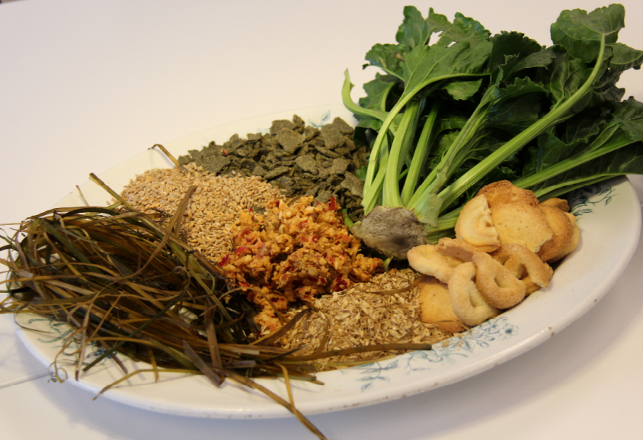
Biocas (July 2017 – Dec 2020)
Project budget: 5 mio. €. GBS budget: 0.25 mio. €
EU Programme: Interreg North Sea, 50 %
Project content
Intensive and cascade utilisation of biomass
Develop value chains from research to production
Develop new local products.
Partnership
Province Friesland, Lead.
Localt partnership: Guldborgsund, CELF, Agrovi and Business Lolland-Falster. 13 partners from Netherlands, Germany, Belgium and Denmark
Results for the municipality
Network with 5 Danish and foreign universities and local business community
Two project applications to Danish national fund for green development for local production and new jobs
A number of initiatives within marine biomass (seaweed and fish)
Two more Interreg projects.

Slide 7
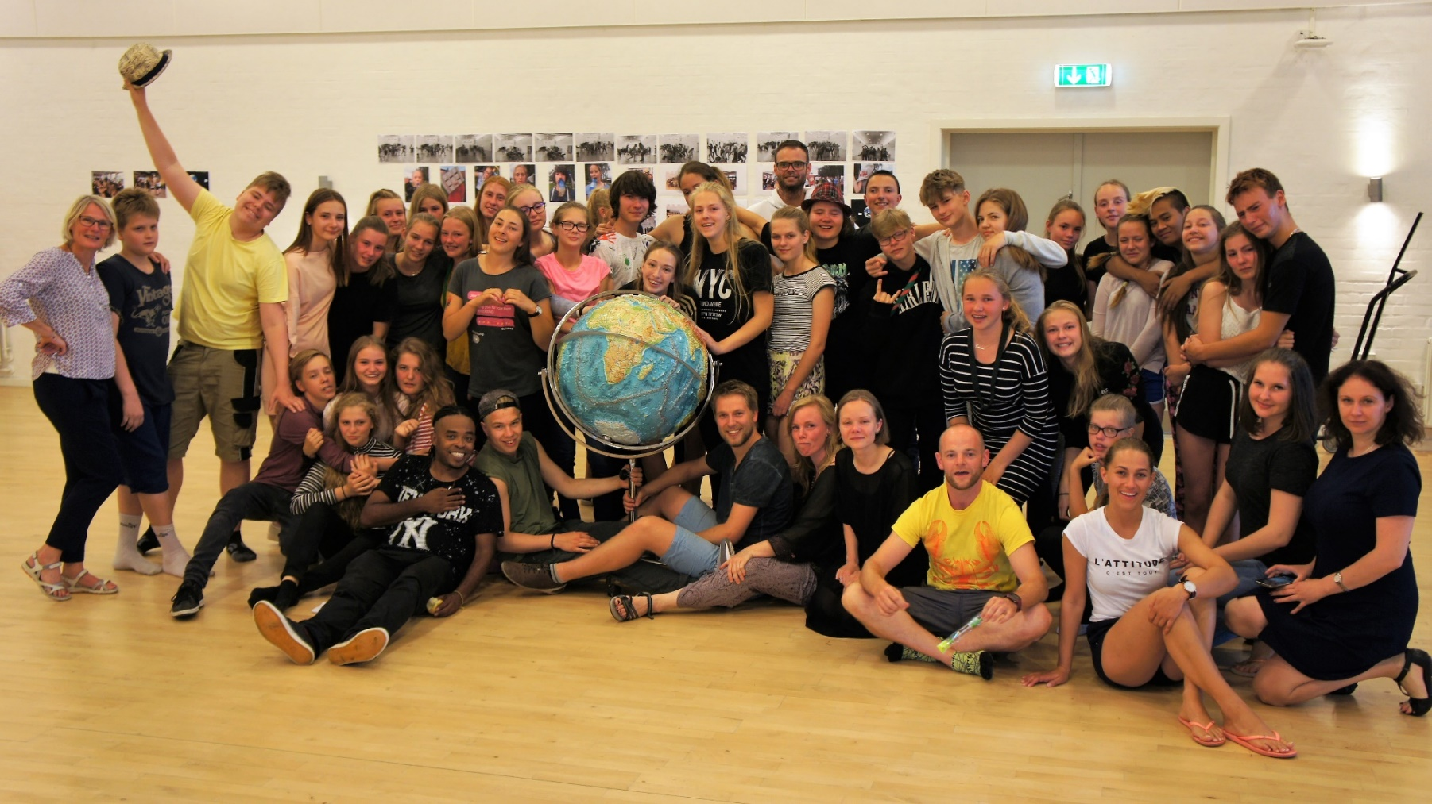
School and education (Exchanges for all)
Cooperation in a network of 15 schools around the South Baltic Sea.
One week camps with workshops on acobatics, musicals and dance.
Young people get international exposure, maturity, self confidence, language training.
2016-2018: 30 youth camps with 1600 young people; 420 from Guldborgsund.

Slide 8
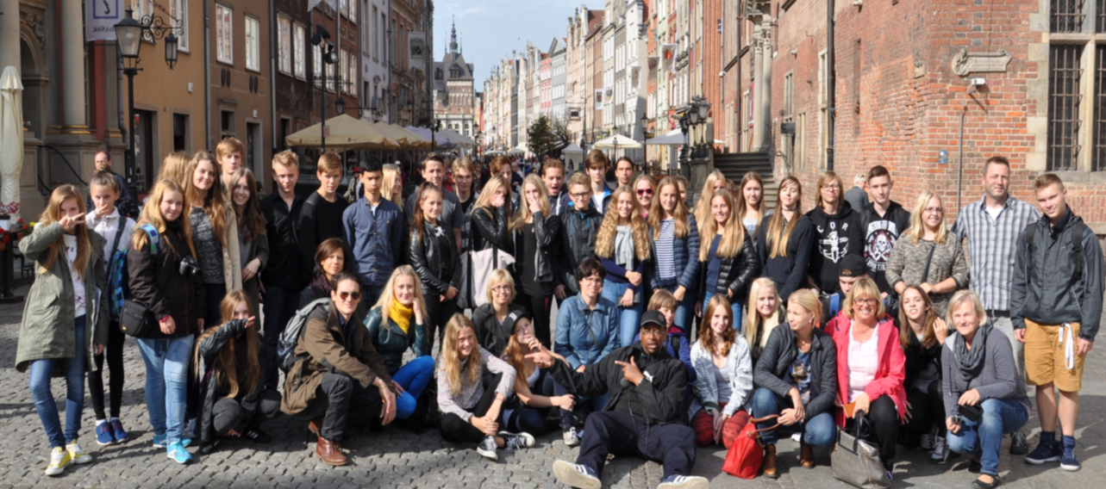
Let’s do it (maj 2016 – juni 2018)
Project budget: 440.000 €. GBS budget: 350.000 €
EU Programme: Interreg South Baltic Sea, 75 %
Partnership
Sophieskolen, GBS is lead.
7 schools from Kalmar, Gdansk, Garzia, Klaipeda + GBS
Project content
Schools in the South Baltic Area cooperate to stop climate changes. Youth camps and school exchanges are included as method.
Results for GBS
10 camps with 600 young people; 200 from GBS schools.
Young people exposed to other countries and cultures providing maturity, self confidence, international outlook and language training.

Slide 9
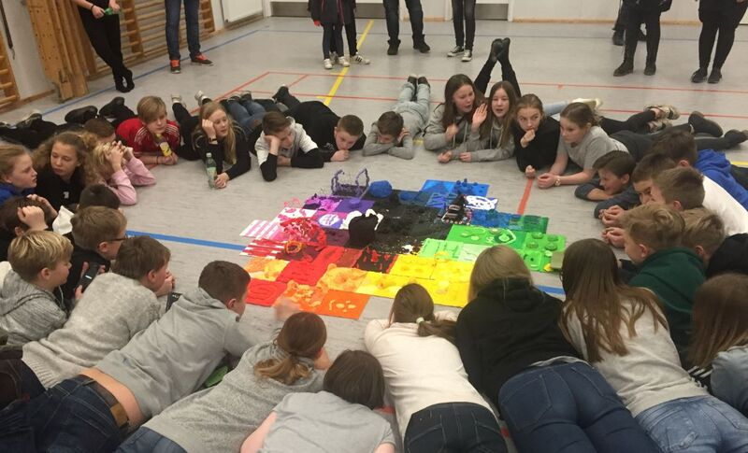
Kultkit (Aug 2018 – Sep 2021)
Joint project budget 1,9 mio. €.
EU Programme: Interreg DE – DK, 75 %
Partnership
Næstved Municipality is Lead
Vordingborg, Lolland and Guldborgsund, Kreis Ostholstein, Hansestadt Lübeck, Stadt Fehmarn + Paritätischer Schl-Hol.
Project content
Local associations participates in cross-border micro-activities.
New communities and networks, better language skills and cultural understanding across Femern Belt.
Results for GBS
2.225 Danish and German people, particularly young people have participated in cross-border mini-projects (2015-2018) .
The mental bridge and intercultural understanding across Femern Belt.

Slide 10
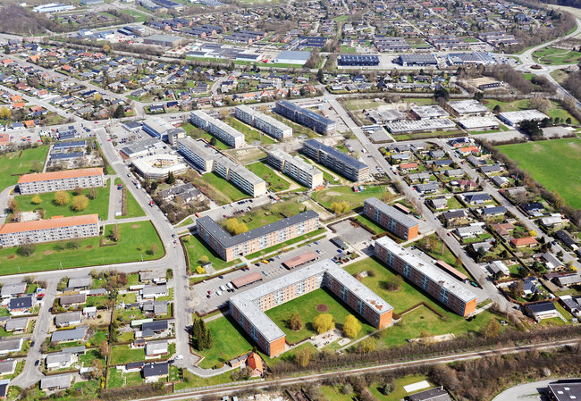
UrbCultural Planning (Jan 2019 – July 2021)
Project budget 2,35 mio. €. GBS budget 150.000 €
EU Programme: Baltic Sea Region, 75 %
Partnership
Danish Cultural Institute is lead.
13 partners from Germany, Poland, Finland, Latvia, Lithuania and Denmark
Project content
Develop methods for using cultural activities and social events for citizens’ involvement in urban planning; focusing on social vulnerable city areas, inclusion and local identity.
Results for GBS
A positive development for social vulnerable city areas Lindholm+Ydre Østerbro.
Realisation of cultural and artistically activities involving the local citizens.
Strenghten positive image and increased knowledge about the city area.

Slide 11
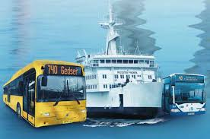
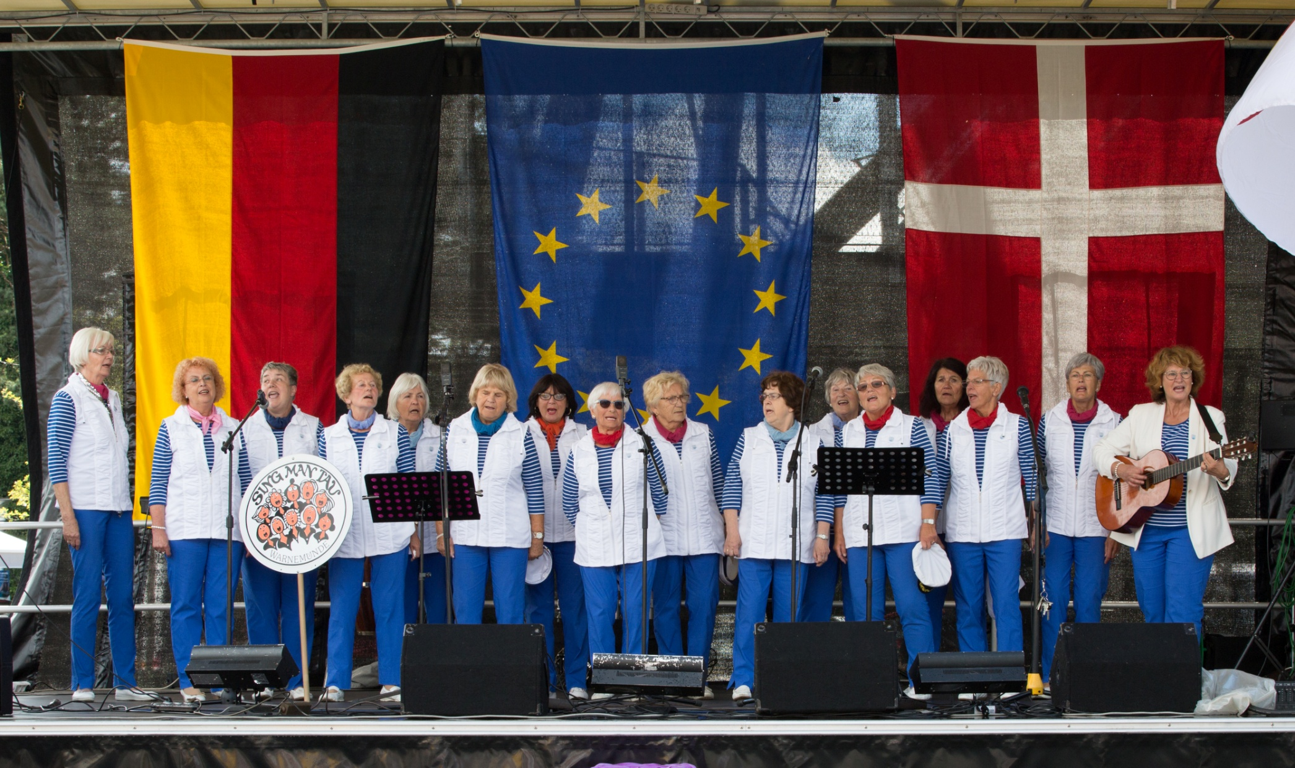
Interconnect (June 2017- May 2020)
Project budget 3.5 mio. €. GBS budget 0.2 mio €
EU Programme: Baltic Sea Region, 75 %
Partnership
Region Blekinge is lead.
8 partners from Germany, Poland, Sweden, Lithuania, Estonia and Denmark.
Project content
Improved public transport services for regional and cross-border travel. Working on “means to go” and “reasons to go”. Increased cooperation with Rostock on education, business and tourism/culture.
Results for GBS
Better transport from hinterland to the transport corridor towards Rostock.
Improved cooperation and knowledge between Rostock and Guldborgsund; involving political level, business, cultural institutions and local citizens associations.

Slide 12
Interreg – close to the regional realities
Programme themes are close to local and regional agendas
Transparent and predictable (7 years programme document)
Regional perspective and regional partners in projects
Programmes are visible and reachable (homepage, info-meetings, project consultations, kick-off meeings)
High success rates for application
However, not much on health, elder care, social issues

Slide 13
How to start working with EU projects?
Say yes to project invitations
Employ / Appoint / an international coordinator
Provide framework and legitimacy to international cooperation
Start picking the low hanging fruits – among the departments and staffs that find international cooperation fun
Contact your EU Bruxelles office
Participate in info-meetings, match-making and programme kickoff meetings
International strategies and organisational changes can wait.

Slide 14
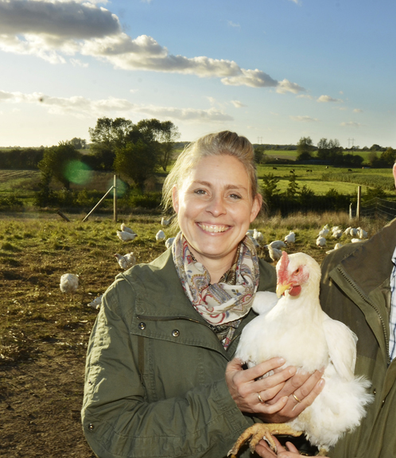
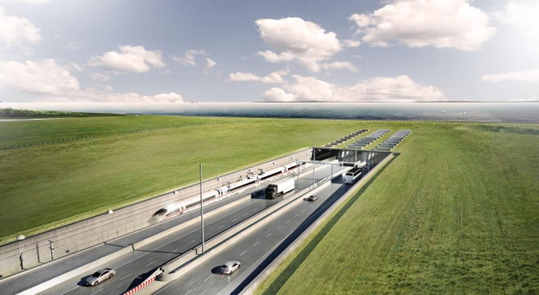
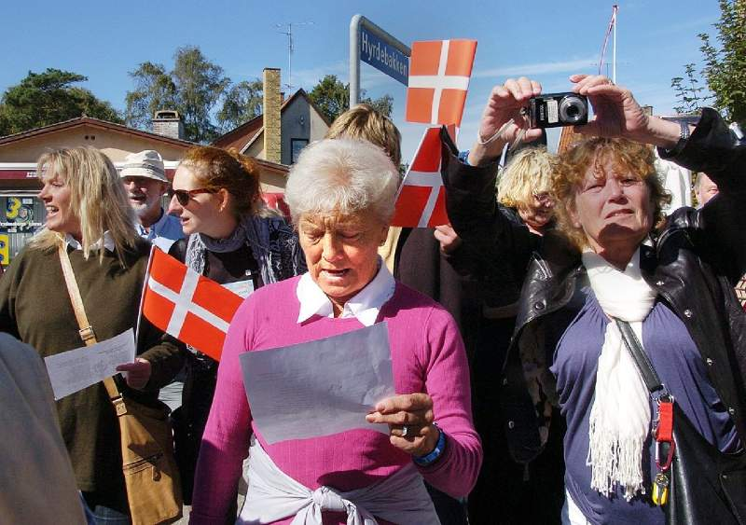
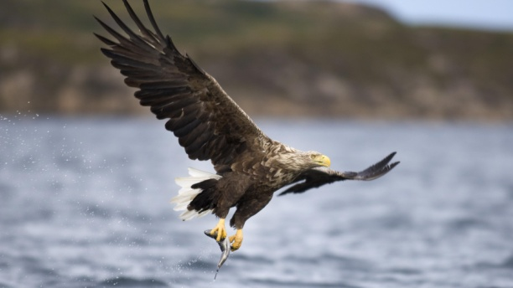
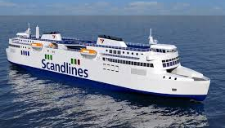
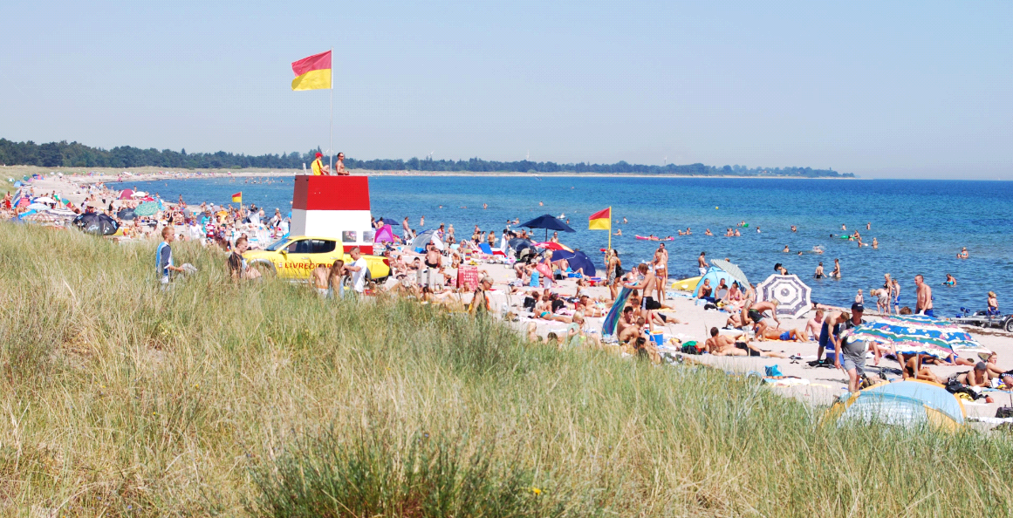
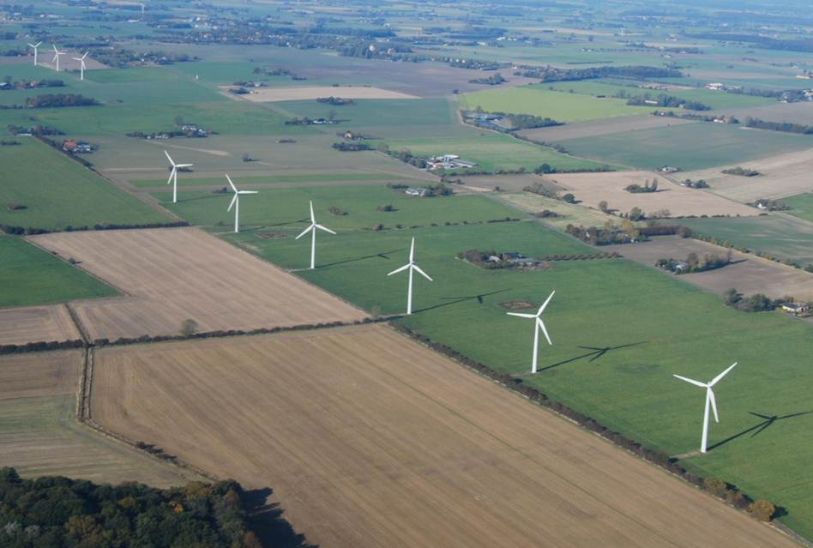
Tak for jeres opmærksomhed
Spørgsmål? Pytania? Questions? Fragor?

