Slide 1
Institutions and Internationalisation - Internationalisation of VET on the institutional level
Presentation at the International Seminar about Municipalities and Educational Institutions in international cooperation
Sorø, Denmark 9th May 2019

Slide 2
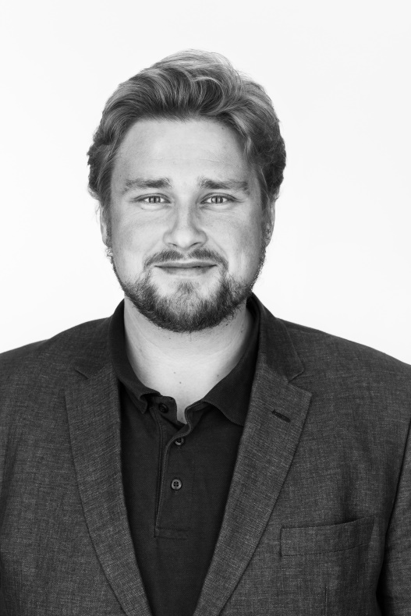
About Me
Claus Brandt Kristensen (M.Sc)
International Officer
The Project Secretariat

Slide 3
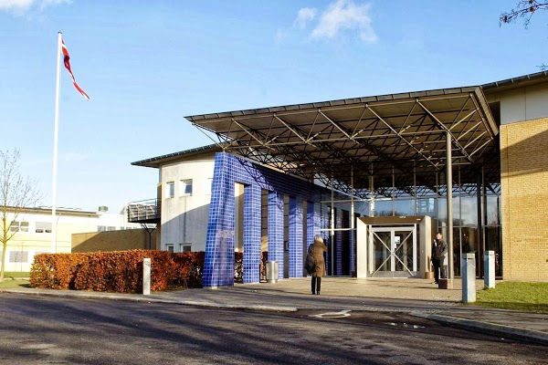
Internationalisation at CELF – organisational development
2009: Fusion between CEUS and EUC Lolland – Establishment of the Project Department
2012: Strategy 2012-2017
  Internationalisation in the Baltic Sea
  Preparing students (and staff) for an international labour market
  Innovation and excellence in VET
2012: Project Department rename Secretariat for Projects and Internationalisation
2012:Performance pay for management level for achieving international goals
2018- : The international strategic goals reminds the same

Slide 4
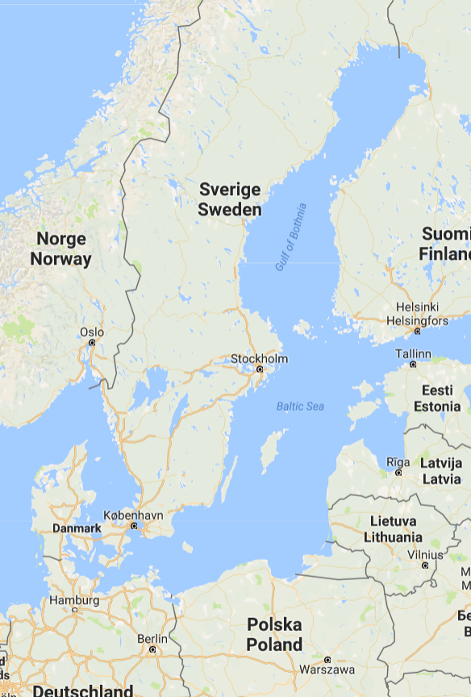
Internationalisation in the Baltic Sea
2010: First big cross-border project VET Qualification System (Interreg. Fehmarn Belt)
2014: Strategic Partnership for the development the Dual System (KA2)
2015: Establishment of Education Office in Lübeck
2016: BBVET project – creating a cross-border VET program (Interreg. South Baltic)
2017: BOOST project - capacity building for a common education and labour market (Interreg. DK-DE)

Slide 5
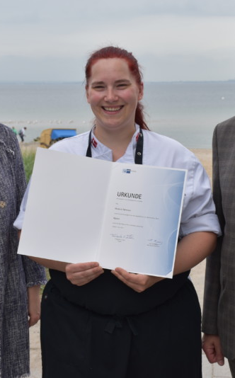
Preparing students (and staff) for an international labour market
2011: First LdV mobility project
  Language and Intercultural awareness
2014: Implementation of ECVET
  HansaECVET (EUSBSR)
2014: CELF as a hosting organisation
  Right skill for the Future (NordPlus)
2015: Innovation and Internationalisation – recognition of Learning Outcomes (LO)
  ZLM 2014-2019 (KA1)
  SEPLO (KA2)
2015: Staff mobility as part of Competence Strategy
  ZLM 2014-2019 (KA1)

Slide 6
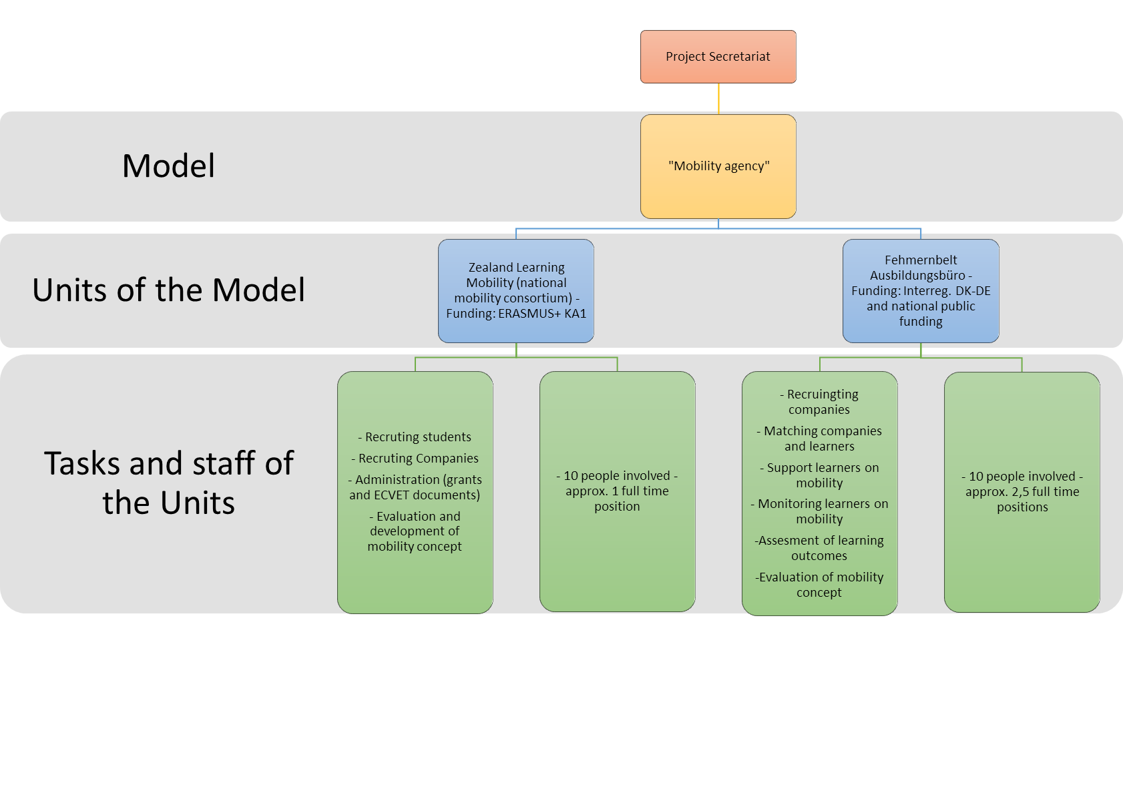
Preparing students (and staff) for an international labour market

Slide 7
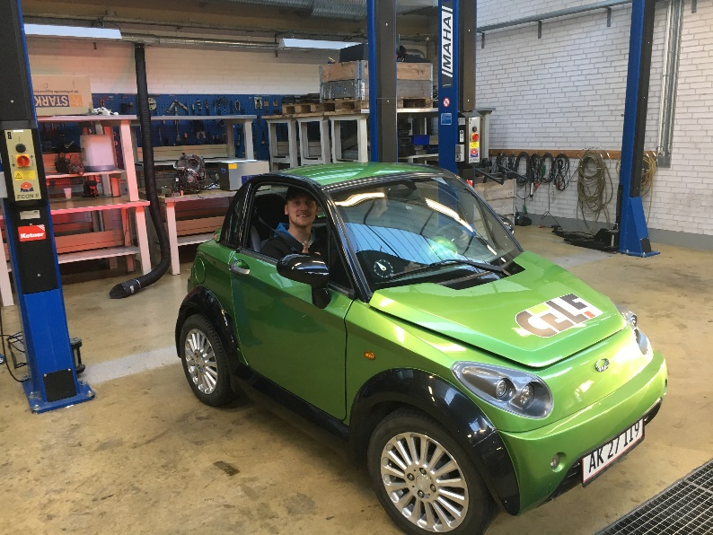
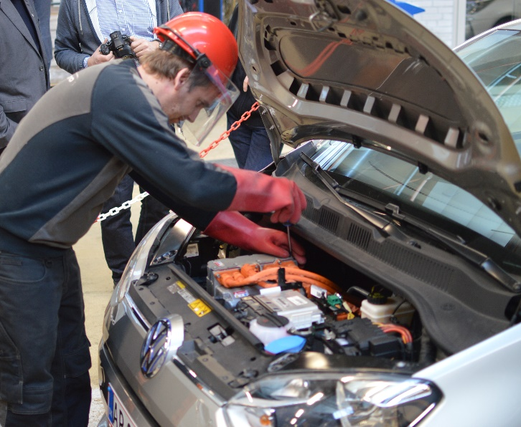
Innovation and excellence in VET
2011: E-bike (LdV partnership)
2012: iEnergy Regio (Interreg Fehmern Belt)
2013:TWIN – E-bike mechanics curricula CVET (LdV ToI)
2014: HansaECVET (EUSBSR)
2015: EIN - Electric car curricula for auto mechanics (KA2)
2016: 50+ back to work
2018: DiVitDE – Didactics in VET in the Digital Era (KA2)
2018: Claus Brandt Kristensen appointed ECVET expert
International competition e.g World Skills

Slide 8
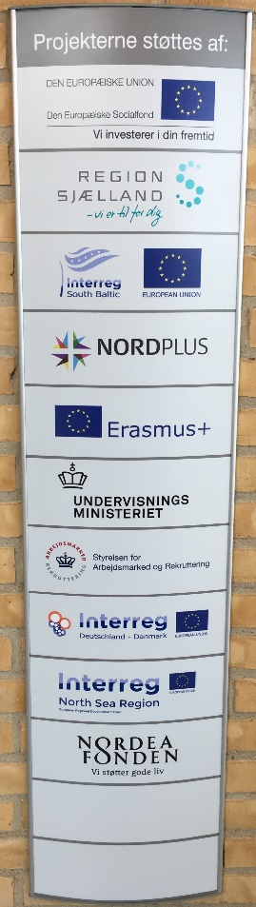
Sum Up
  A clear international strategy for your institution - this is your compass
  Strong and sustainable project department or team with a diversified competence profile and with a clear mandate from the management that secures some freedom degrees from day to day operations
  Keep the eye on the target – be critical to which projects you participate in
  Networking – get close to stakeholders at all levels local, regional, national and international – this takes time!
  Create your own knowledge base – keep yourself updated on the news in political development and the research in the field of VET. Cedefop is a good place to start.

Slide 9
Thank you for your attention
For further information please contact:
International Officer
Claus Brandt Kristensen
+45 61221630
clkr@celf.dk
https://www.facebook.com/clausbrandtk

