Slide 1
Boosting Cross-border cooperation capacities of local actors in the South Baltic Sea
Anna Topp Gustavsen
Sorø, 9 May 2019

Slide 2
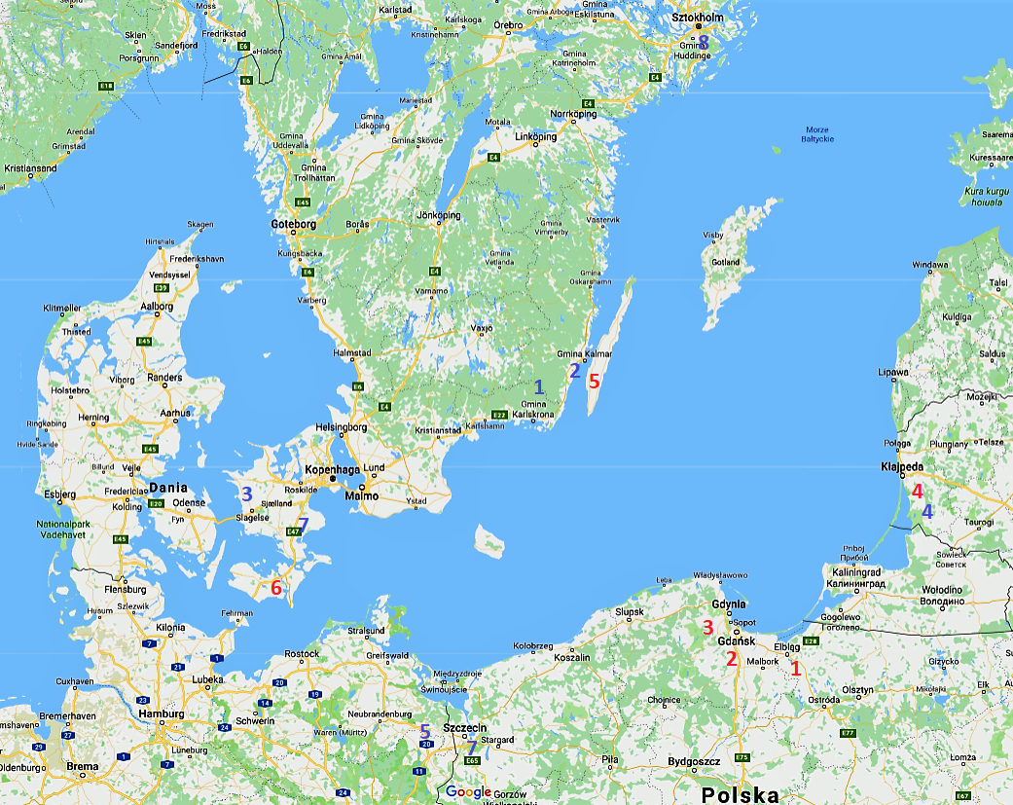
UMBRELLA PARTNERSHIP
4 COUNTRIES
6 PROJECT PARTNERS
8 ASSOCIATED PARTNERS

Slide 3
WHY DO WE NEED THE UMBRELLA PROJECT?
To break down barriers
- Motivate more actors (newcomers in particular) to take part in international cooperation and EU-projects.

Slide 4
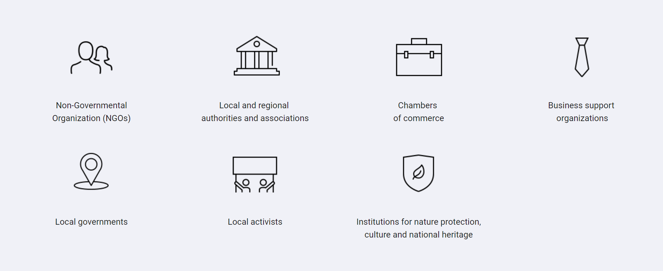
The project is directed to:

Slide 5
WHAT DO WE OFFER?
AWARENESS RAISING EVENTS
WHO? Possible stakeholders, They can be newcomers in Cross-border cooperation, small local and regional authorities
WHAT? Inspirational talks, Overview on past and currents CBC projects in the region in the INTERREG South Baltic, INTERREG Baltic Sea, Erasmus +, Europe for Citizens.
WHERE & WHEN? - Gdansk: Umbrella Awareness Raising Event (11-12 June 2018)
- Sorø (9 May 2019)
WHY? To raise awareness among the stakeholders on Cross-Border Cooperation, EU Grants, Initiatives, Opportunities in the Baltic Sea Region

Slide 6
WHAT DO WE OFFER?
MICRO-ACTIVITIES
WHO? Beneficiaries interested in relevant cooperation areas.
WHAT? Finance micro-activities for beneficiaries (travel and accommodation), in order to help them better understand the added value of cross-border cooperation. The goal of the micro-activities would be to simulate real life cross-border projects yet with little to no administrative or financial burdens on the beneficiaries.
Activities: study visits, face-to-face meetings, conferences, reports on particular aspects of cooperation, rental of experts etc
WHERE & WHEN? Poland, Lithuania, Sweden, Denmark, Germany
WHY? The aim of those micro-activities will be to create dedicated cross-border networks in specific areas. Beneficiaries of the micro-activities will be able to use the knowledge, expertise and experience gained during the implementation, to later submit full-scale or small-scale applications to the regular SBP or other funds calls.

Slide 7
WHAT DO WE OFFER?
CROSS-BORDER WORKSHOP & «RENT-AN-EXPERT» SERVICE
WHO? Beneficiaries that have identified relevant themes or concrete ideas for development of projects within the SBP or other ETCP
WHAT? The workshops will have both panel sessions as well as discussion sessions in smaller groups for better interaction possibilities. Such smaller groups will discuss about topics like: Active communication between beneficiaries, Project proposals, in the form of one page summary. Presented project, ideas will be assessed by experts’ panel that gives direct feedback and suggest next steps in the project preparation. Finally, selected project will be able to receive support by “rent-an-expert" facility, to finalise applications to be submitted to SBP or other ETC Funds
WHERE & WHEN? Poland, Lithuania, Sweden, Denmark, Germany
        Lund, Feb 2019
WHY? The participation in cross border workshops will prepare potential beneficiaries for concrete cooperation in joint projects. Participants will be profiled and put into thematic groups.

Slide 8
WHAT DO WE OFFER?
CROSS-BORDER CONFERENCES WITH POLICY AREA PANEL
WHO? Beneficiaries interested in specific topics
WHAT? Selected beneficiaries grouped around their PA and will meet with experts. The conferences will have both panel sessions as well as discussion sessions in smaller groups for better interaction possibilities.
WHERE & WHEN? Sweden, Poland & Demanrk
WHY? The participation in cross border workshops with PA panels will provide beneficiaries with relevant information in a specific thematic area for the preparation of future project applications.
First CBC Conference: 18th-19th September in Kalmar (Sweden): Topic: Bio-Economy
Gdansk (PL), end of October. Topics: Energy; Urban Mobility
Denmark, November. Topic: Tourism

Slide 9
WHAT’S NEXT?
NATIONAL TRAININGS
WHO? All beneficiaries (Newcomers, Intermediates, Experts) with different approaches, contents, focus according to their level of experience in cross-border cooperation.
WHAT? Trainings will be organized in the manner to respond to the specific requirements, problems and barriers in every region covered. Trainings will be held in national languages, in groups of 15 to 25 people.
WHERE & WHEN? Poland, Lithuania, Denmark, Sweden
WHY? The objective is to train potential project developers with the strong focus on “newcomers” and support them in project development.

Slide 10

WHAT’s NEXT?
SUCCESS STORIES BOOK

Slide 11
WORKSHOP TOPICS
Renewable / Sustainable Energy
Cultural Cooperation
Educational Cooperation
The frame of the workshops
Presentation of you and your organisation.
  Are their any ideas/ intersts / priorities you want to focus on?
Your experience in international cooperation or ecxpectations for internation cooperation
Expectations to our Umbrella offers

